Slide 1
SHORT-TERM INTERNSHIP
ON
ARTIFICIAL INTELLIGENCE
B.KAVYA SRI
23555A0502
CSE-A

Slide 2
ABSTRACT
The Internship aimed to explore the forefront of artificial intelligence and technologies at the Artificial Intelligence Medical and Engineering Researchers Society (AIMER Society) focused on Generative AI, computer vision, chatbot development, and visual question answering. Initially concentrated on computer vision, covering techniques in image processing , image classification and object detection.
Additionally, examined various AI tools and techniques, including the use of advanced models and practical applications including GEMINI, ROBOFLOW, POWERBI, etc..

Slide 3
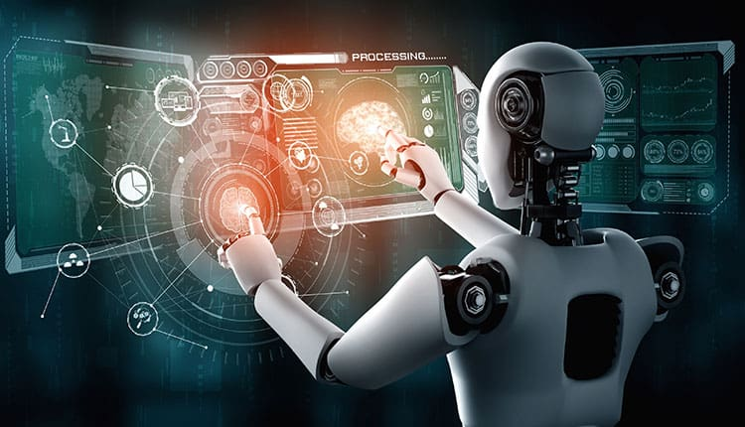
ARTIFICIAL INTELLIGENCE
Artificial Intelligence is a set of technologies that enable computers to perform a variety of advanced functions , including the ability see , understand and translate spoken and written language.
Artificial Intelligence is the backbone of the innovation in modern computing , unlocking value for individuals and business
Artificial intelligence (AI)is important because it can perform tasks that typically require human intelligence such as understanding language , recognizing patterns and making decisions.

Slide 4
Applications of AI:
Artificial Intelligence has various applications in today's society. It is becoming essential for today's time because it can solve complex problems with an efficient way in multiple industries, such as Healthcare, entertainment, finance, education, etc. AI is making our daily life more comfortable and fast.

Slide 5
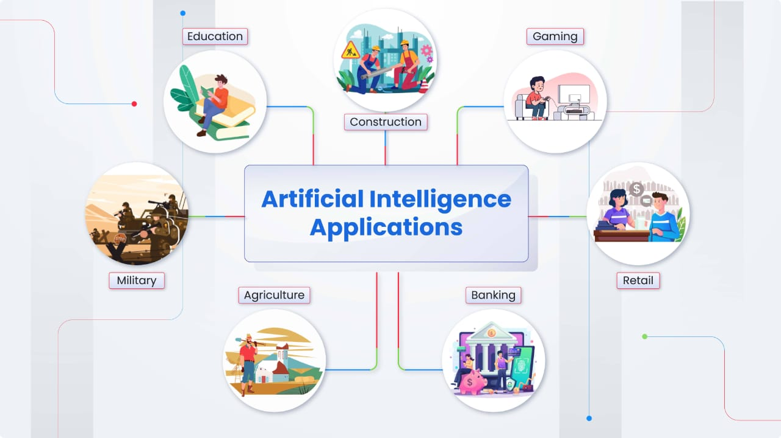
Following are some sectors which have the application of Artificial Intelligence:

Slide 6
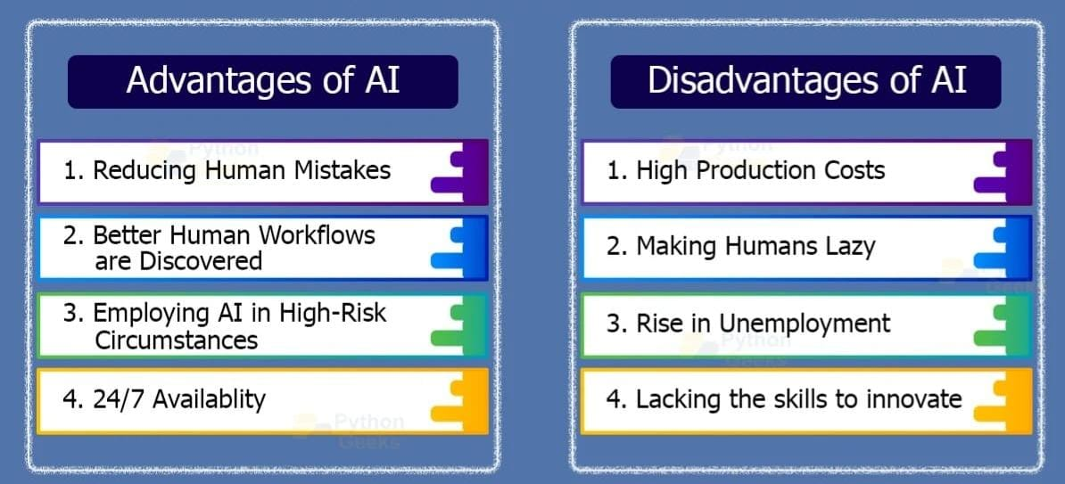
advantages and disadvantages of AI

Slide 7
VARIOUS TASKS PERFORMED DURING INTERNSHIP:
Chat Bot
Object Detection
Data Visualization using Power BI
Talking parrot

Slide 8
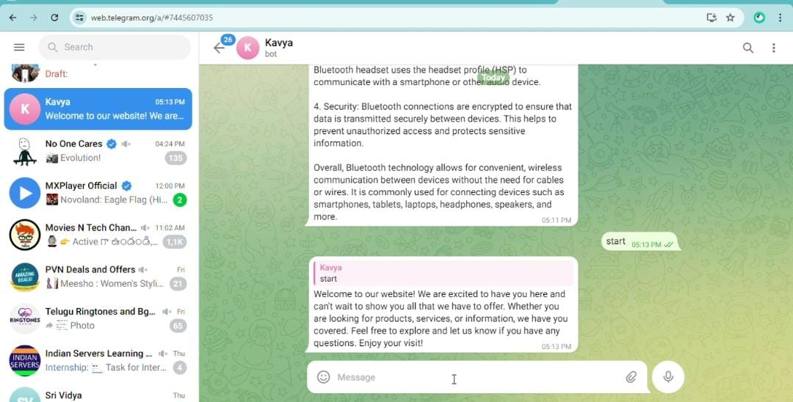
CHAT BOT:
A Telegram chatbot is a computer program that uses artificial intelligence (AI) to communicate with humans through messaging apps.
Open Telegram and search for the Bot Father.
Start a chat with Bot Father and use the /new Bot command to create a new bot.
Follow the prompts to name your bot and choose a username.
Once created, you’ll receive a token. .
Execute your Python script to start the bot.
Open Telegram, search for your bot (using the username you set), and start a chat

Slide 9
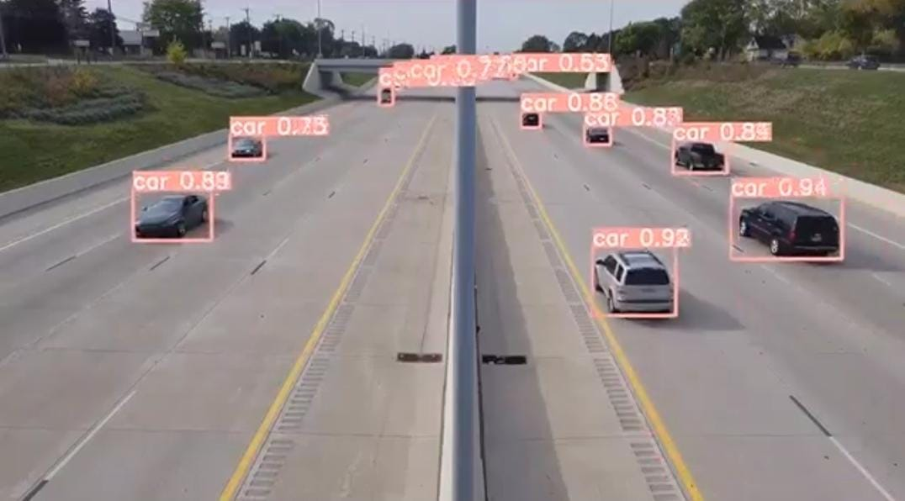
Object Detection:
Object detection is a computer vision task that involves identifying and locating objects in images or videos. It is an important part of many applications, such as self-driving cars, robotics, and video surveillance. One of the most popular neural networks for this task is YOLO.

Slide 10
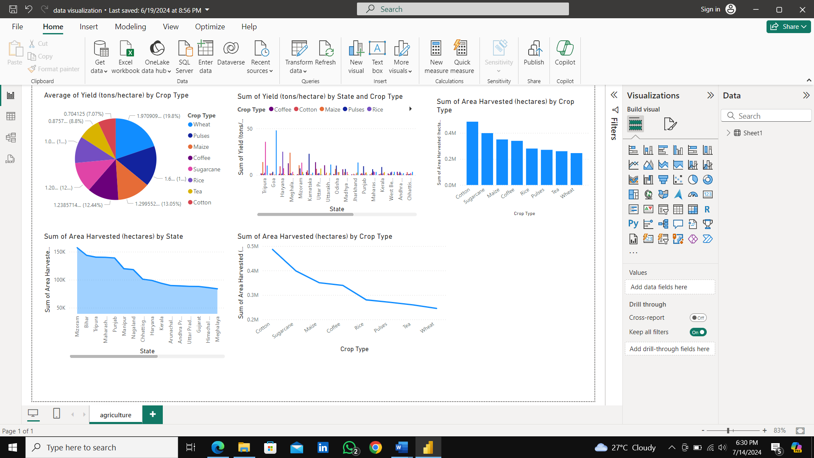
Data Visualization using Power BI:
Data visualization is the representation of data through use of common graphics, such as charts, plots, infographics and even animations. Power BI is a technology-driven business intelligence tool provided by Microsoft for analyzing and visualizing raw data to present actionable information.

Slide 11
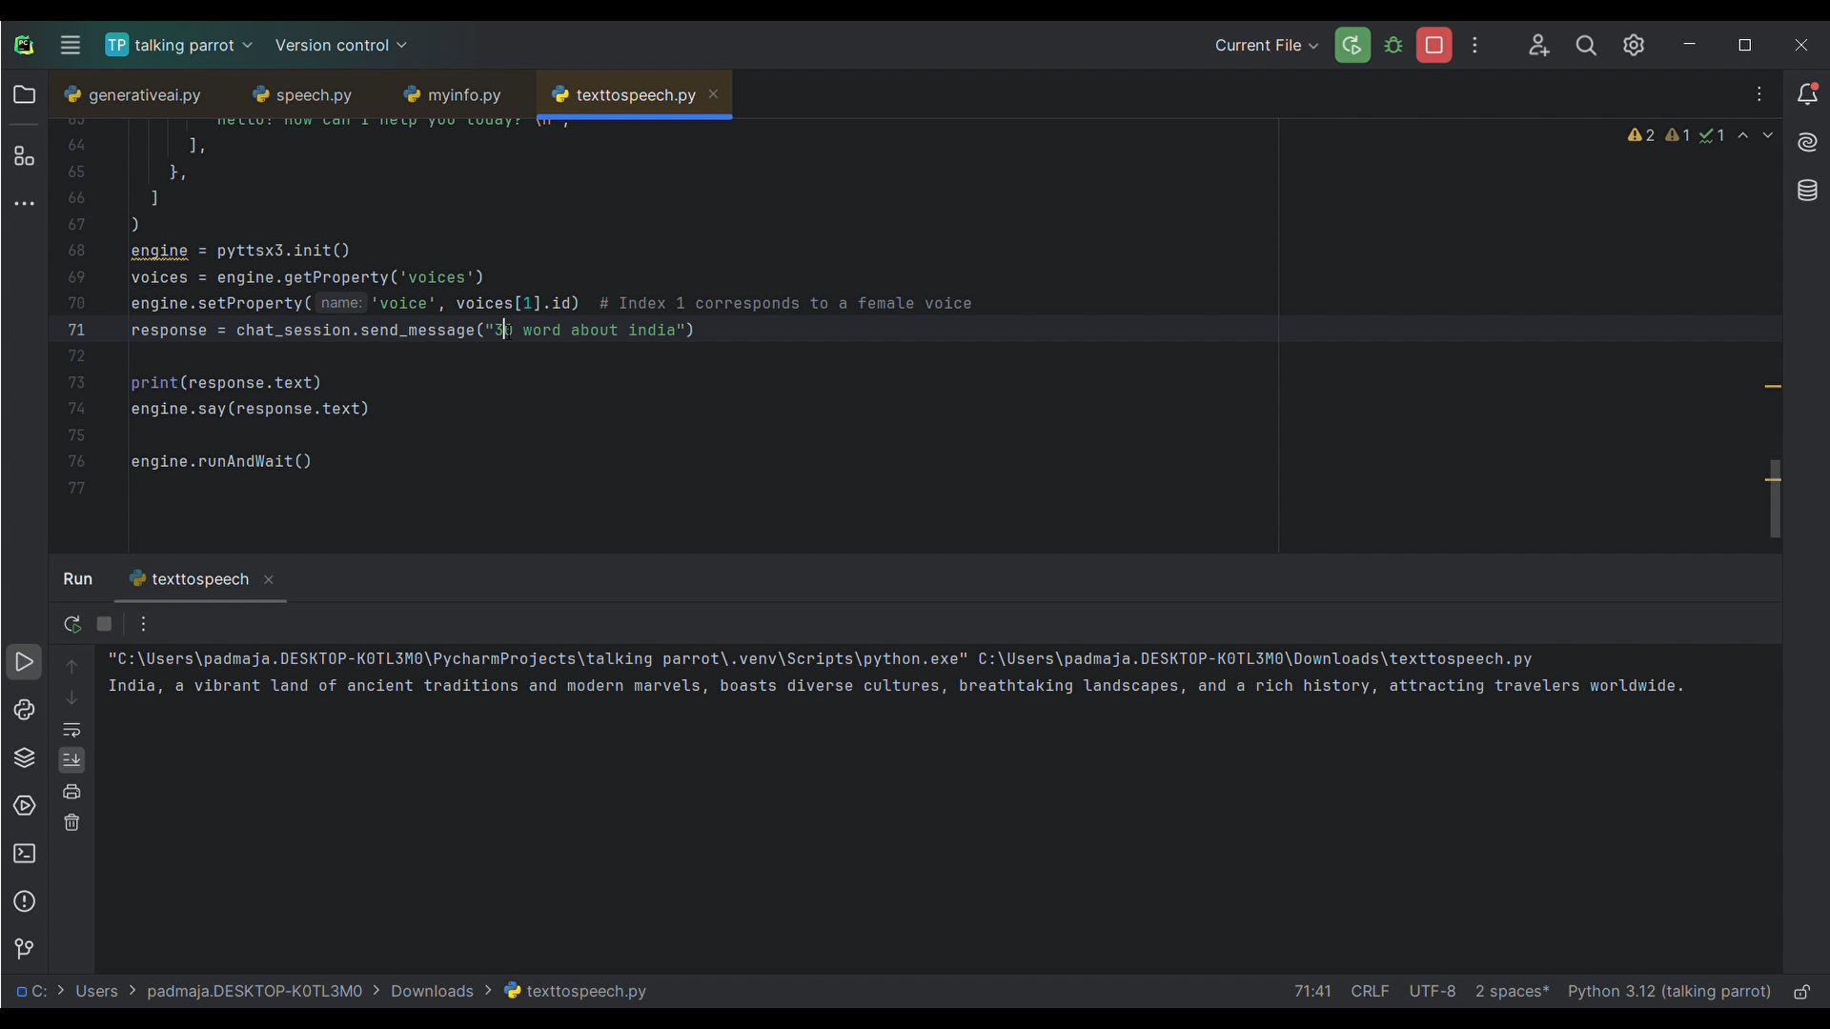
Talking parrot:
A talking parrot project involves creating an interactive system where a virtual or physical parrot can mimic speech or engage in conversations. This can be achieved through:
Text-to-Speech (TTS) Technology: To make the parrot "talk" by generating human-like speech from text.
Speech Recognition: To enable the parrot to understand and respond to spoken input.
Natural Language Processing (NLP): To interpret and generate meaningful responses.

Slide 12
CONCLUSION:
The main theme of this AI concept is how we can utilize the AI services in Real life activities and complete the work in easy and early by interact with AI and smart devices.

Slide 13
THANK YOU

